Slide 1


Slide 2
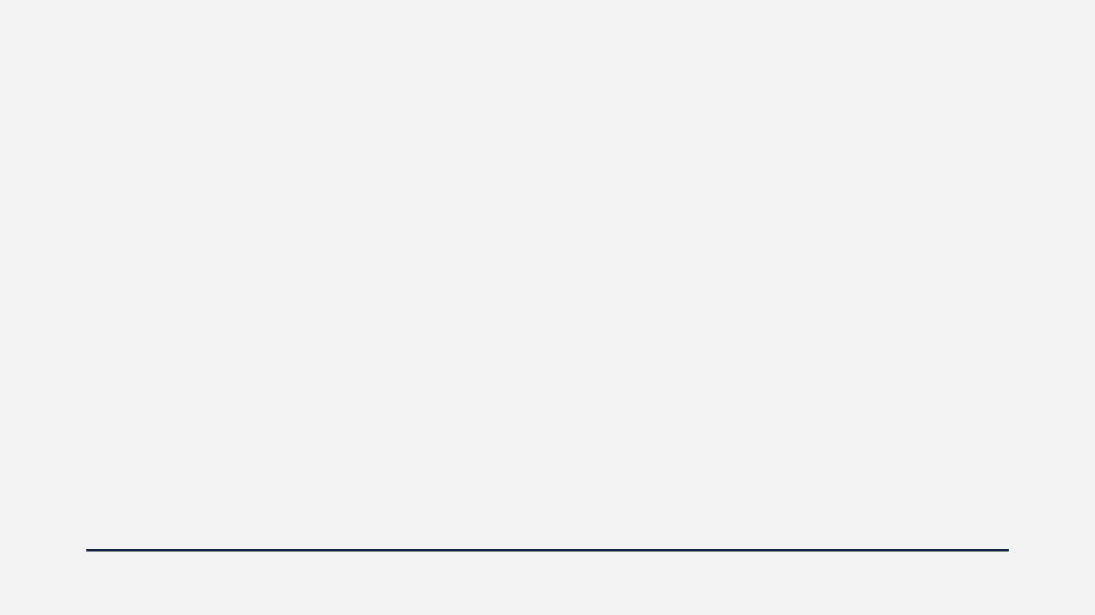



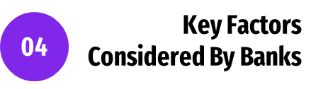


Slide 3
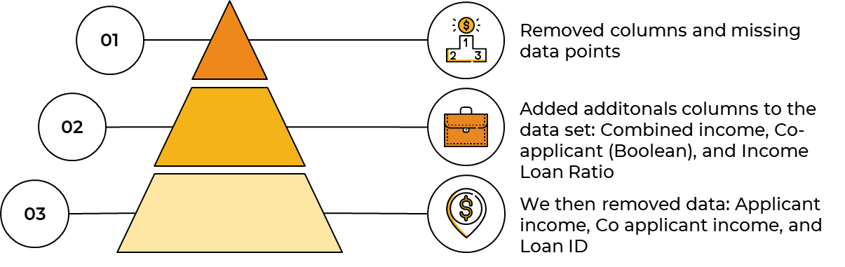

Slide 4
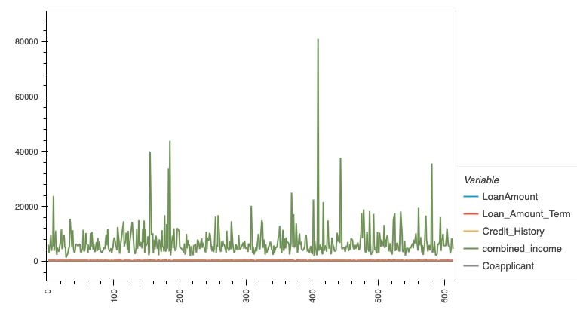
Notes:
HV plot shows the distribution of the data columns that had numerical data
Shows outliers along with trends or patterns (combined income shows the most variance), but have to remember this is before data is cleaned/scaled

Slide 5
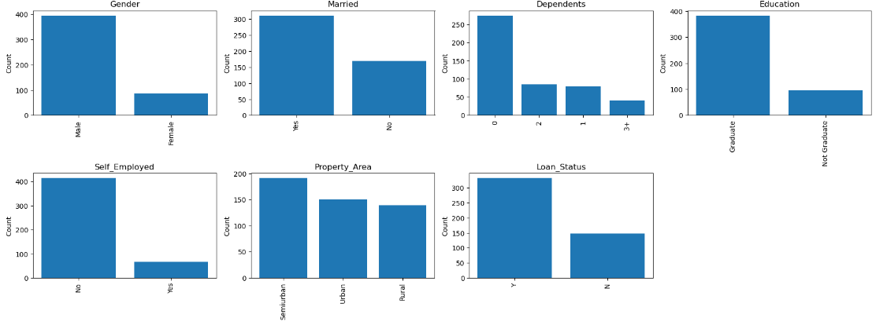
Notes:
We then generated a grid of bar charts, where each chart represents the distribution of a categorical variable in the dataset. Each bar chart shows the count of occurrences for the variable that were objects (strings) such as Male/Female, Married/Not, Education/No Education to give an idea of what that distribution of data was.
Some have more of a variance between counts than others
Married yes/no is about 2:1; which is similar shape to Loan Status
While large variance between male/female, Education/Not Education, and Self-employed/Not

Slide 6
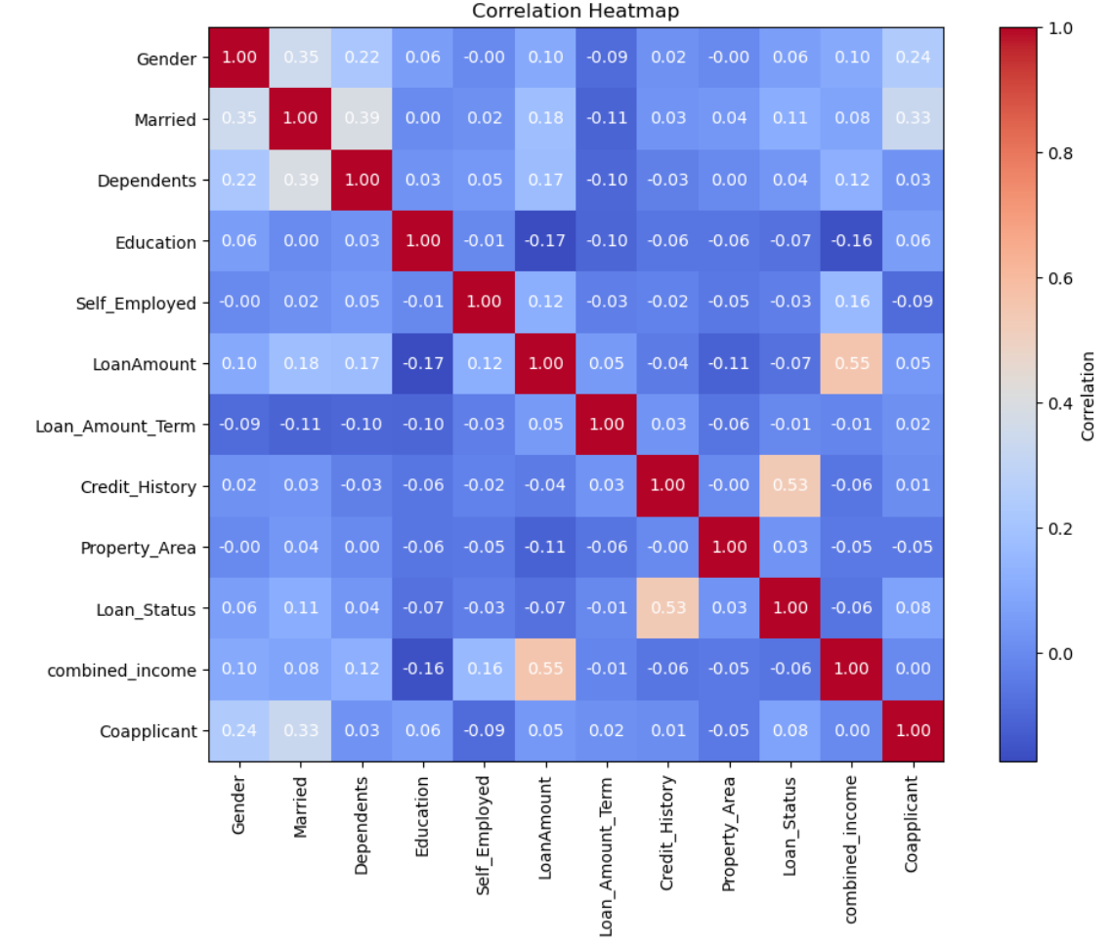
Notes:
Did LabelEncoder for heatmap, this made it so that all variables were in numerical form and could be compared for relationships
We then created a correlation heat map to gain insights into the relationships between variables in a dataset. We found strong positive correlations between credit history and loan status; credit history and loan status with correlation of 0.53
Credit history is numerical so it wasn’t on the categorical data variables
Loan amount and Combined income also showed correlation but our question was focused on loan status
Combined income and loan status only had -0.06

Slide 7
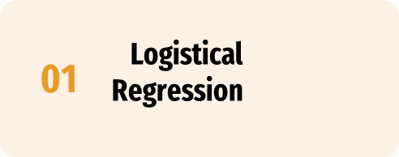


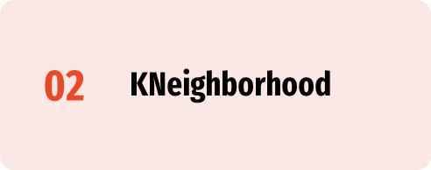
Notes:
Logistical Regression: Logistical regression estimates the probability that a given observation belongs to a certain category, assumes that the relationship between the independent variables and the log-odds of the outcome is linear
KNeighboorhood: KNN is an example of instance-based learning or lazy learning, where the model does not explicitly learn a function from the training data. Instead, it memorizes the training instances and makes predictions based on similarity between new instances and training the data.

Slide 8
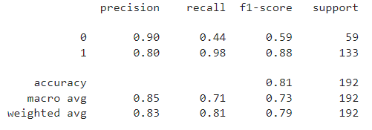
Notes:
Jess
In the classification report for the logistic regression model with all columns included, we observe a precision of 0.90 for unapproved loans (class 0), indicating that 90% of the instances predicted as unapproved were actually unapproved. For approved loans (class 1), the precision is 0.80, suggesting that 80% of the instances predicted as approved loans were actually approved. Furthermore, the recall for unapproved loans is 0.44, meaning that the model correctly identified 44% of the actual unapproved loans, while for approved loans, the recall is high at 0.98, indicating that the model correctly identified 98% of the actual approved loans. The F1-score, which balances precision and recall, is 0.59 for unapproved loans and 0.88 for approved loans. The overall accuracy of the model is 0.81, meaning that it correctly predicted the loan status in 81% of cases. Overall, while the model demonstrates high precision and recall for approved loans, there is room for improvement in correctly identifying unapproved loans, as indicated by the lower recall and F1-score for this class.
Here's what each metric means:
**Precision**: Precision is the ratio of correctly predicted positive observations (true positives) to the total predicted positives (true positives + false positives). It measures the accuracy of positive predictions.
- **Recall**: Recall is the ratio of correctly predicted positive observations (true positives) to the total actual positives (true positives + false negatives). It measures the ability of the model to find all the positive instances.
- **F1-score**: The F1-score is the harmonic mean of precision and recall. It provides a single metric that combines both precision and recall.
- **Support**: Support is the number of actual occurrences of the class in the specified dataset.
- **Accuracy**: Accuracy is the ratio of correctly predicted observations (both true positives and true negatives) to the total observations.
- **Macro Avg**: Macro average calculates the average of the metrics (precision, recall, F1-score) for each class, giving each class equal weight.
- **Weighted Avg**: Weighted average calculates the weighted average of the metrics for each class, with the weights being the support for each class.
Overall, this classification report provides insights into how well the model performs for each class and overall. It shows the balance between precision and recall and helps evaluate the model's effectiveness in classifying loans as approved or not approved.

Slide 9
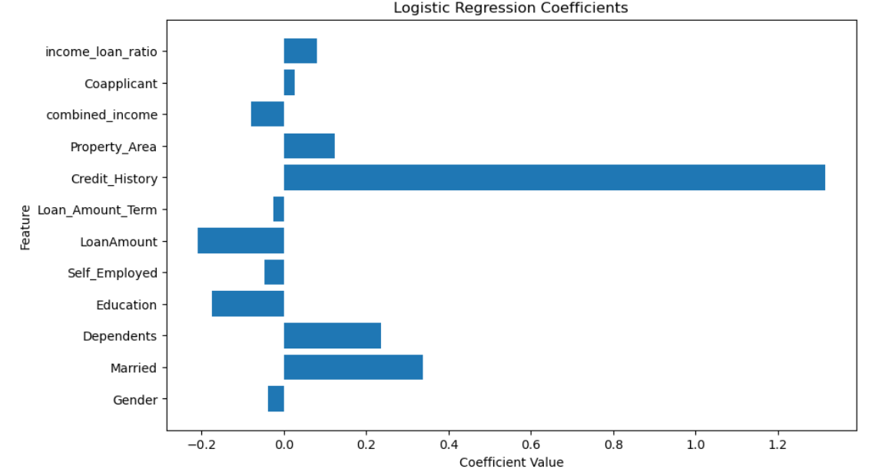
Notes:
Jess
The above horizontal bar chart shows the coefficients of each feature in the logistic regression model. Positive coefficients indicate features that positively contribute to the prediction of the target variable, while negative coefficients indicate features that negatively contribute to the prediction.

Slide 10
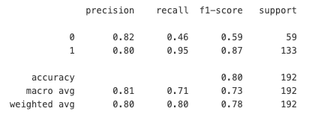
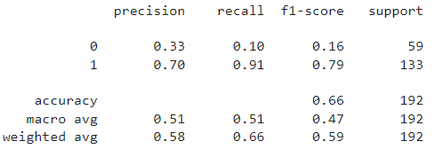
Without ‘Married’
Without ‘Credit History’
Notes:
Jess
Here's what each metric means:
**Precision**: Precision is the ratio of correctly predicted positive observations (true positives) to the total predicted positives (true positives + false positives). It measures the accuracy of positive predictions.
- **Recall**: Recall is the ratio of correctly predicted positive observations (true positives) to the total actual positives (true positives + false negatives). It measures the ability of the model to find all the positive instances.
- **F1-score**: The F1-score is the harmonic mean of precision and recall. It provides a single metric that combines both precision and recall.
- **Support**: Support is the number of actual occurrences of the class in the specified dataset.
- **Accuracy**: Accuracy is the ratio of correctly predicted observations (both true positives and true negatives) to the total observations.
- **Macro Avg**: Macro average calculates the average of the metrics (precision, recall, F1-score) for each class, giving each class equal weight.
- **Weighted Avg**: Weighted average calculates the weighted average of the metrics for each class, with the weights being the support for each class.

Slide 11
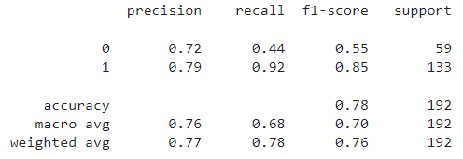
Notes:
Fizza
In the classification report for a KNeighborsClassifier model. It correctly identifies 72% of non-approved loans and 79% of approved ones.
Recall measures the model's ability to capture all relevant instances, with 44% for non-approved loans and 92% for approved ones.
F1 score is 0.55 for not-approved and 0.85 for approved loans.
The support values indicate 59 instances of non-approved loans and 133 instances of approved ones.
Overall accuracy stands at 78%, indicating correct predictions in 78% of cases. While the model performs well in predicting approved loans, there's room for improvement in identifying non-approved ones.

Slide 12
Without ‘Married’
Without ‘Credit History’
Notes:
Fizza
Without the 'Married' column, the precision, recall, and F1-score for both loan approval classes are notably higher compared to the model without the 'Credit_history' column. The improved metrics imply that 'Married' contributes less to classification accuracy than 'Credit_history'.
Without the 'Credit_history' column, there's a notable decrease in precision, recall, and F1-score for non-approved loans compared to the model without the 'Married' column. The lower overall accuracy of the model without 'Credit_history' (0.66) reinforces the importance of credit history in loan approval decisions.

Slide 13
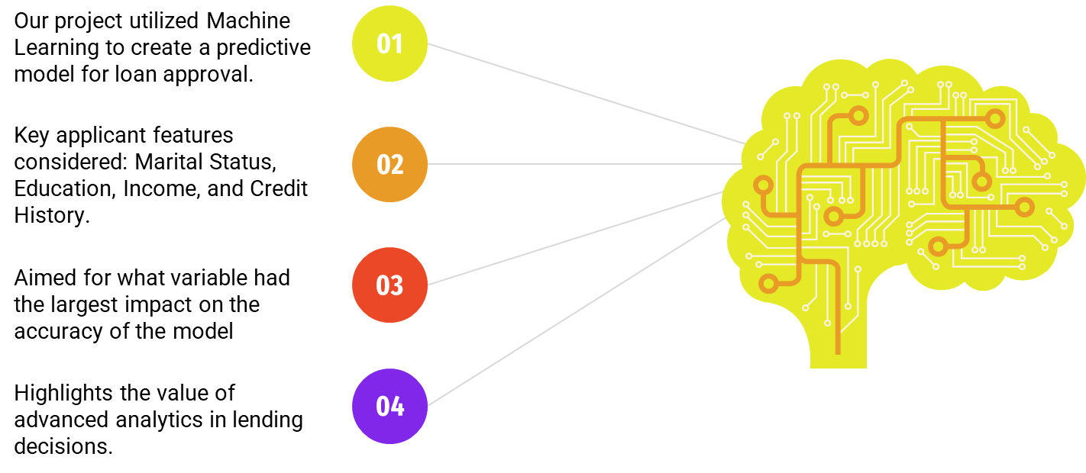
Notes:
Fizza

Slide 14
1. Vivek Muraleedharan. (n.d.). Loan Prediction Dataset. Kaggle. Retrieved from https://www.kaggle.com/code/vivekmuraleedharan/loan-prediction/input](https://www.kaggle.com/code/vivekmuraleedharan/loan-prediction/input)
2. Life Sherpa. (n.d.). Top 9 Things Banks Look for When Approving Home Loans. Retrieved from https://lifesherpa.com.au/articles/top-9-things-banks-look-for-when-approving-home-loans](https://lifesherpa.com.au/articles/top-9-things-banks-look-for-when-approving-home-loans)
3. Altruist Delhi. (n.d.). Loan Prediction Problem Dataset. Kaggle. Retrieved from https://www.kaggle.com/datasets/altruistdelhite04/loan-prediction-problem-dataset?resource=download](https://www.kaggle.com/datasets/altruistdelhite04/loan-prediction-problem-dataset?resource=download)
4. GeeksforGeeks. (n.d.). Loan Approval Prediction using Machine Learning. Retrieved from https://www.geeksforgeeks.org/loan-approval-prediction-using-machine-learning/](https://www.geeksforgeeks.org/loan-approval-prediction-using-machine-learning/)
5. GeeksforGeeks. (n.d.). Loan Eligibility Prediction using Machine Learning Models in Python. Retrieved from https://www.geeksforgeeks.org/loan-eligibility-prediction-using-machine-learning-models-in-python/](https://www.geeksforgeeks.org/loan-eligibility-prediction-using-machine-learning-models-in-python/)

